Slide 1
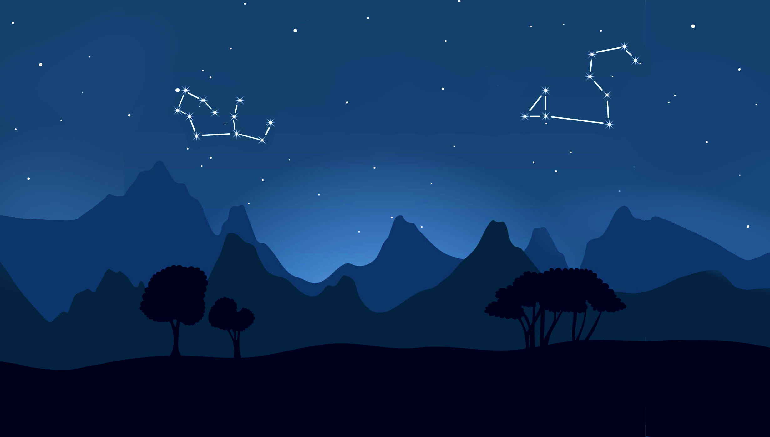
Plant a tree
A solution to crowd lending and crowd funding

Slide 2


Target audience
Students who need urgent money esp those with project ideas
Investors willing to help fund projects and locate talents

Slide 3
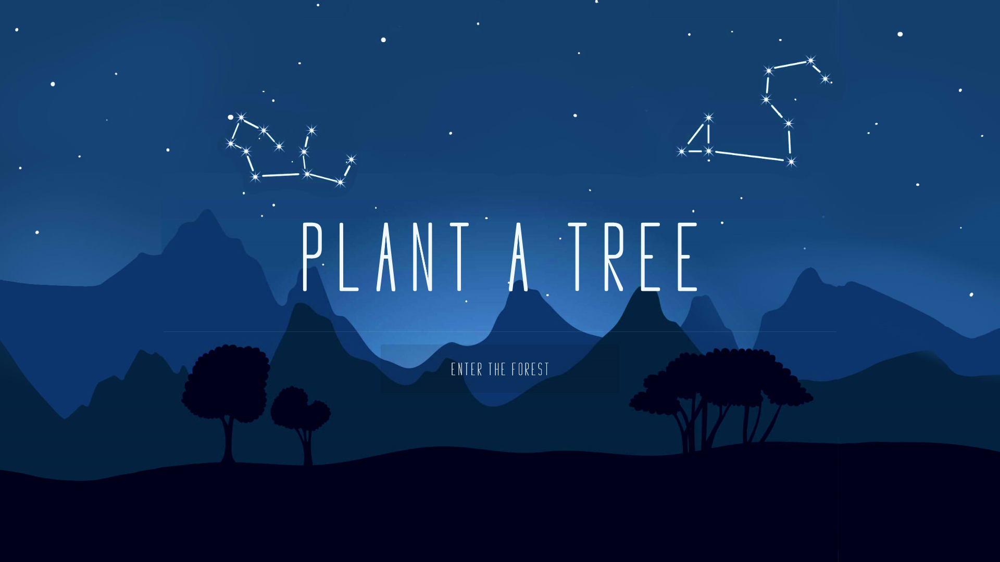

Slide 4
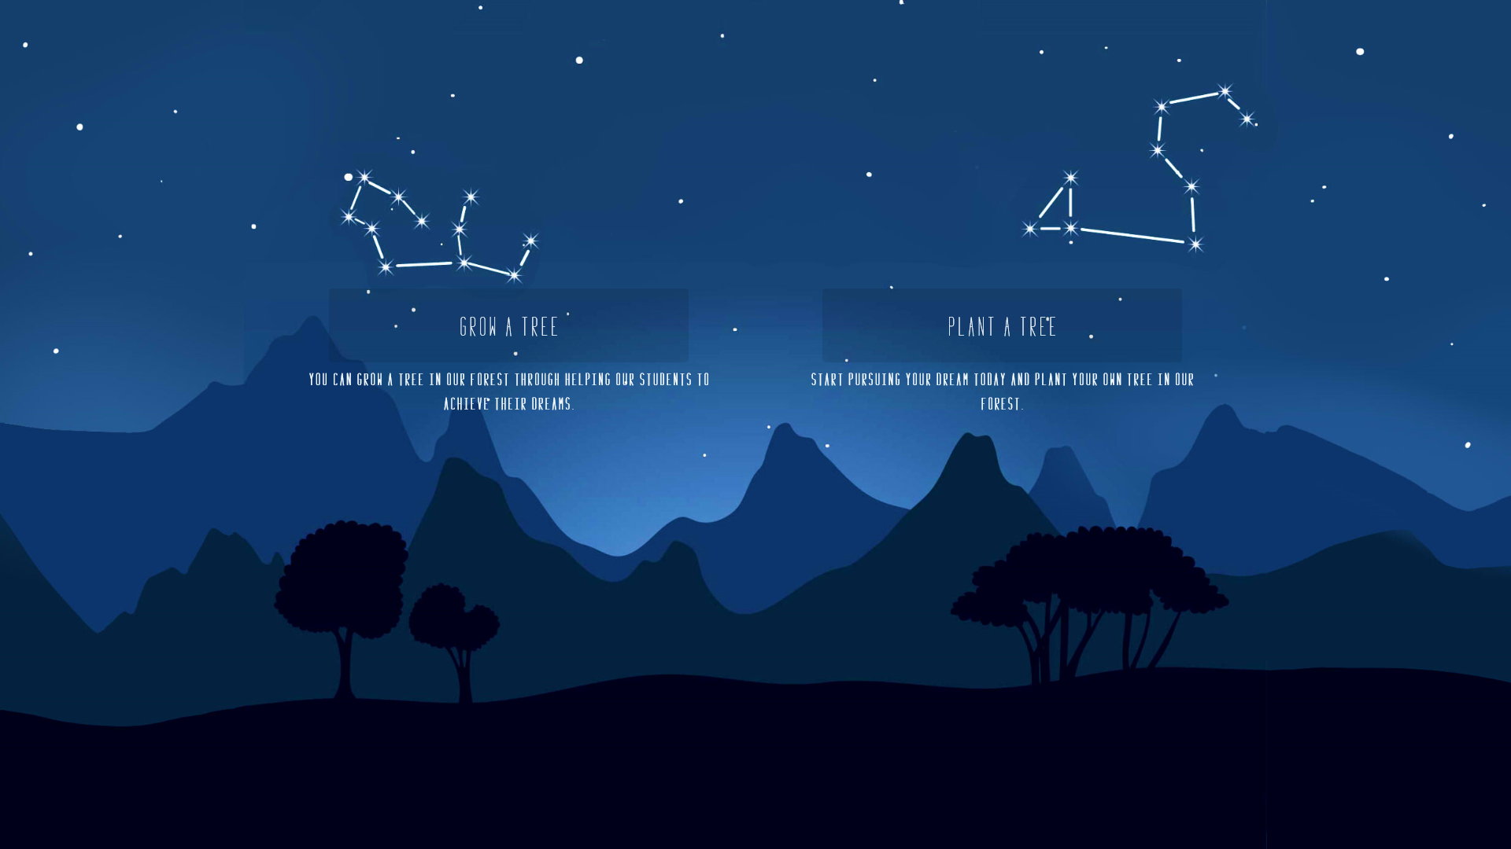

Slide 5
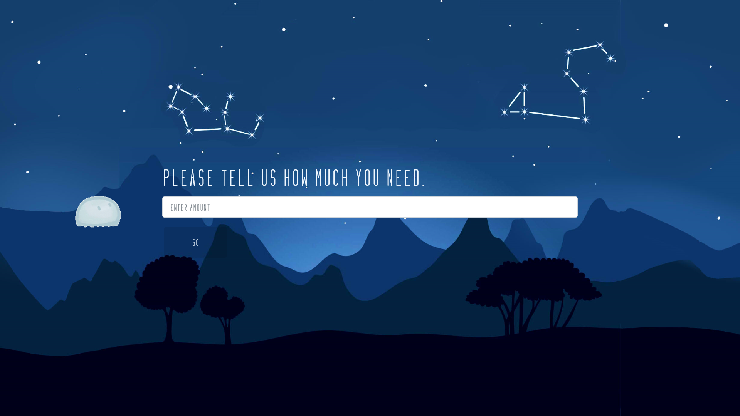

Slide 6
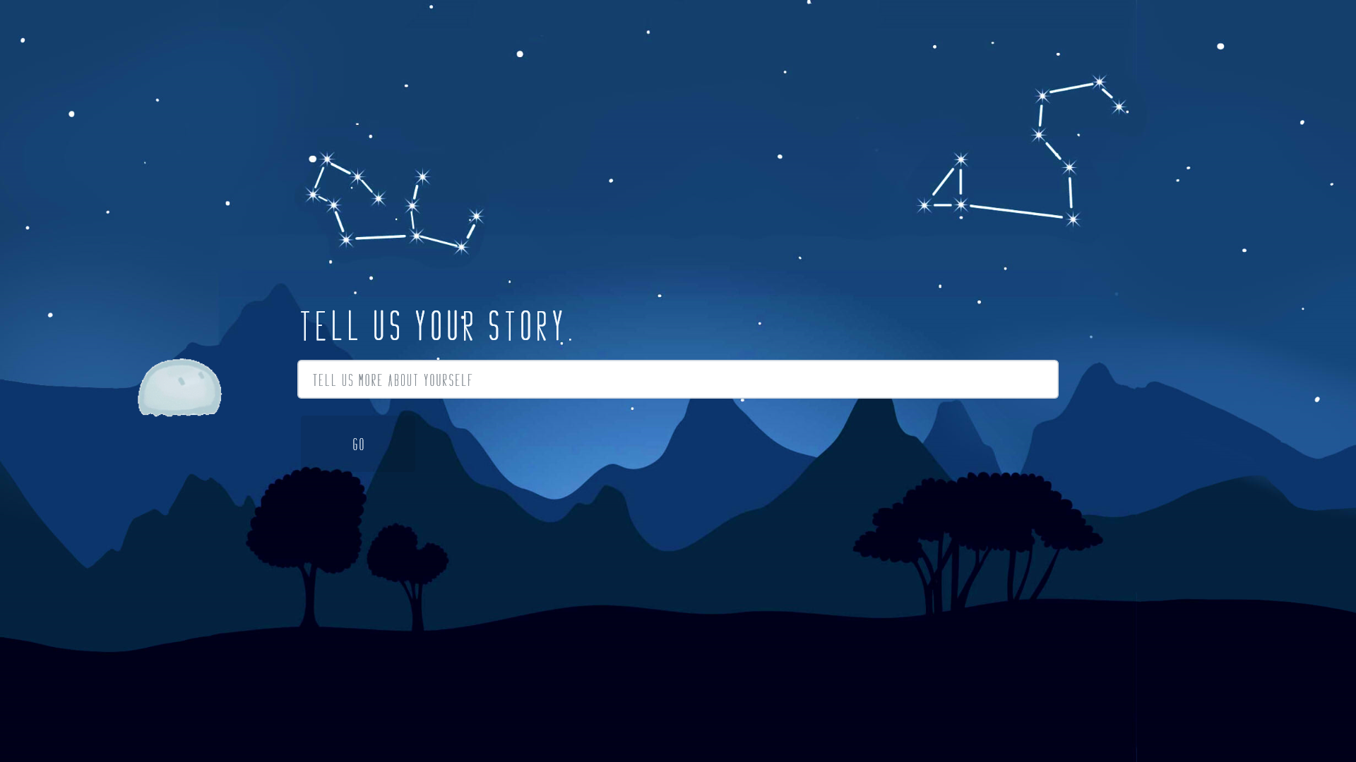

Slide 7
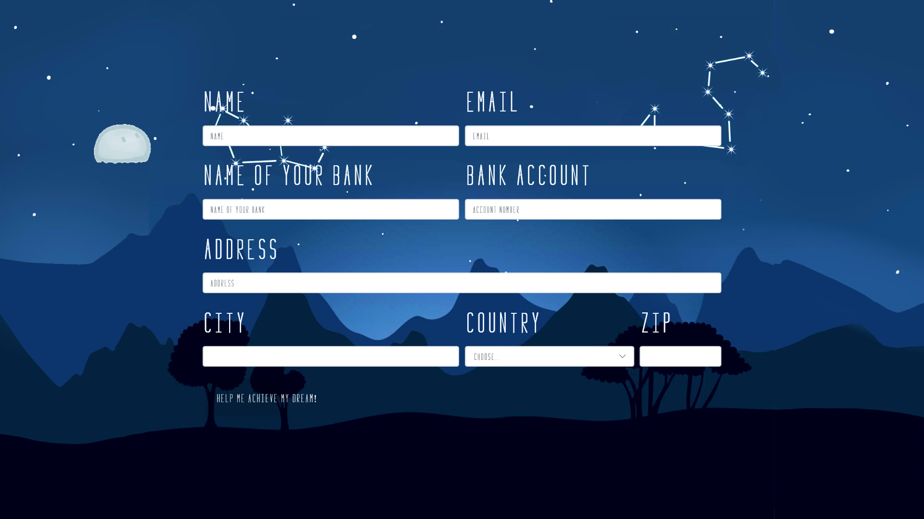

Slide 8

You are all set

Slide 10
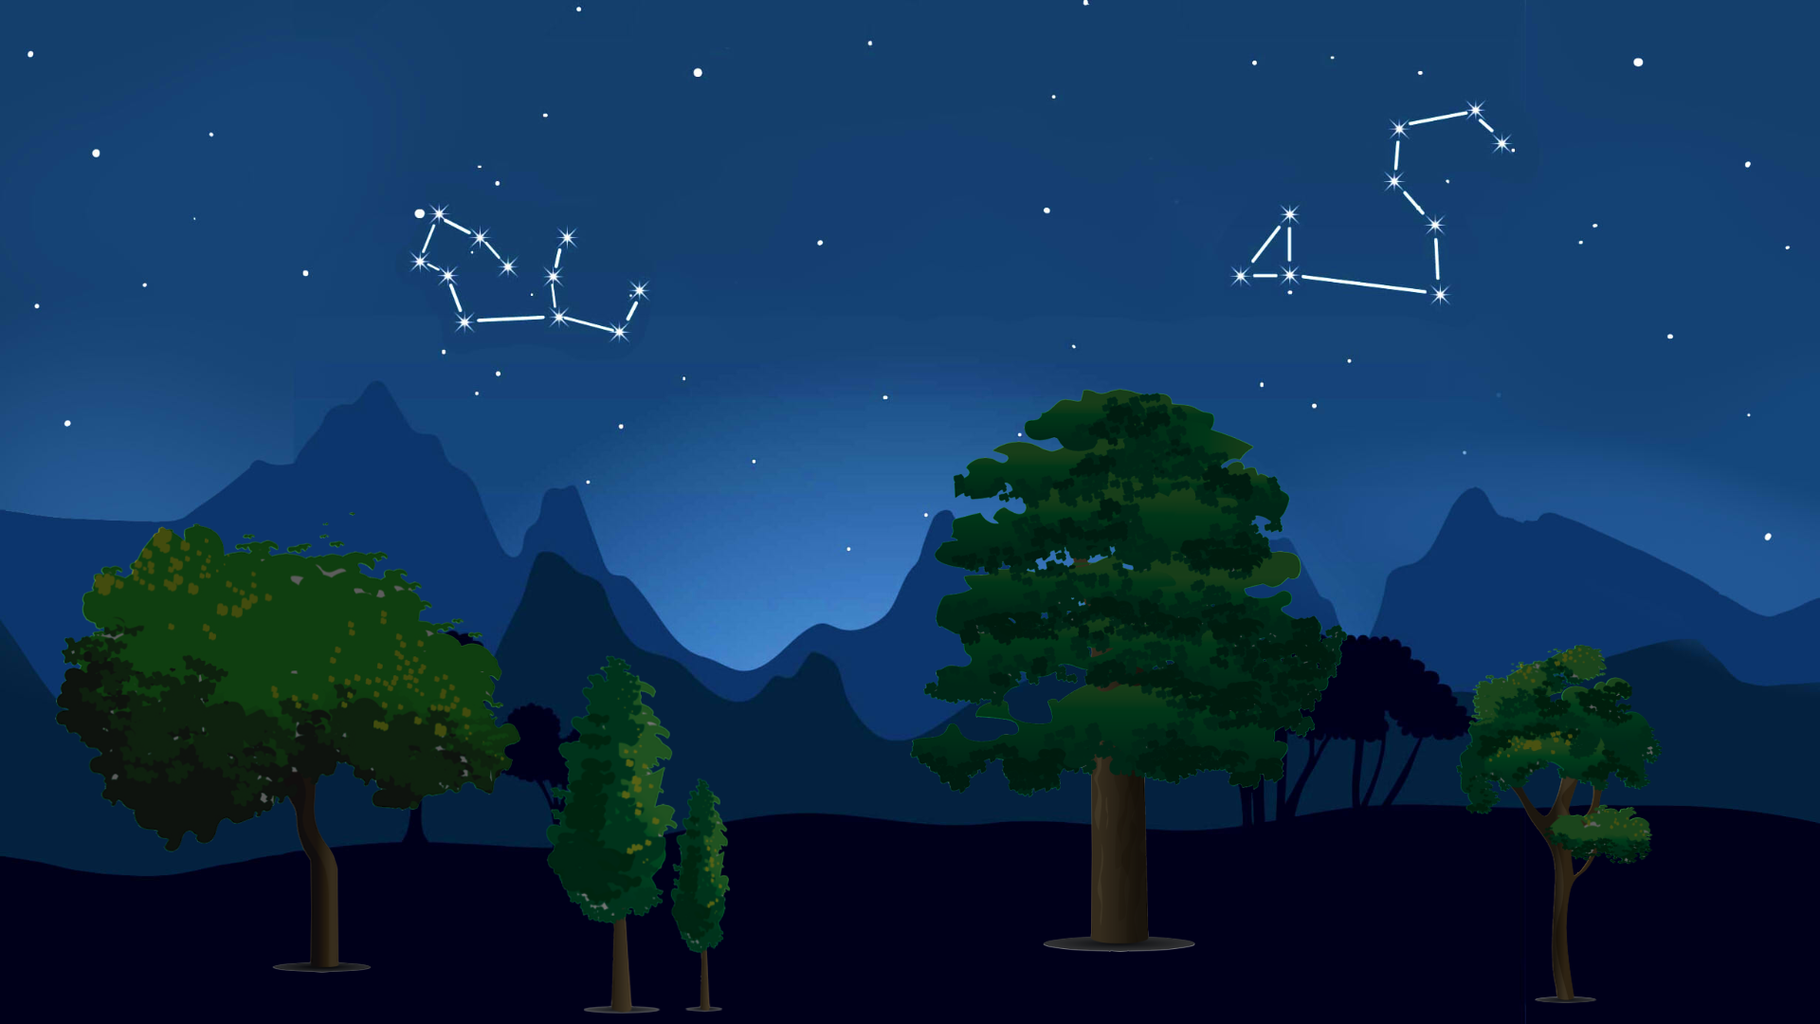
Login

Slide 11
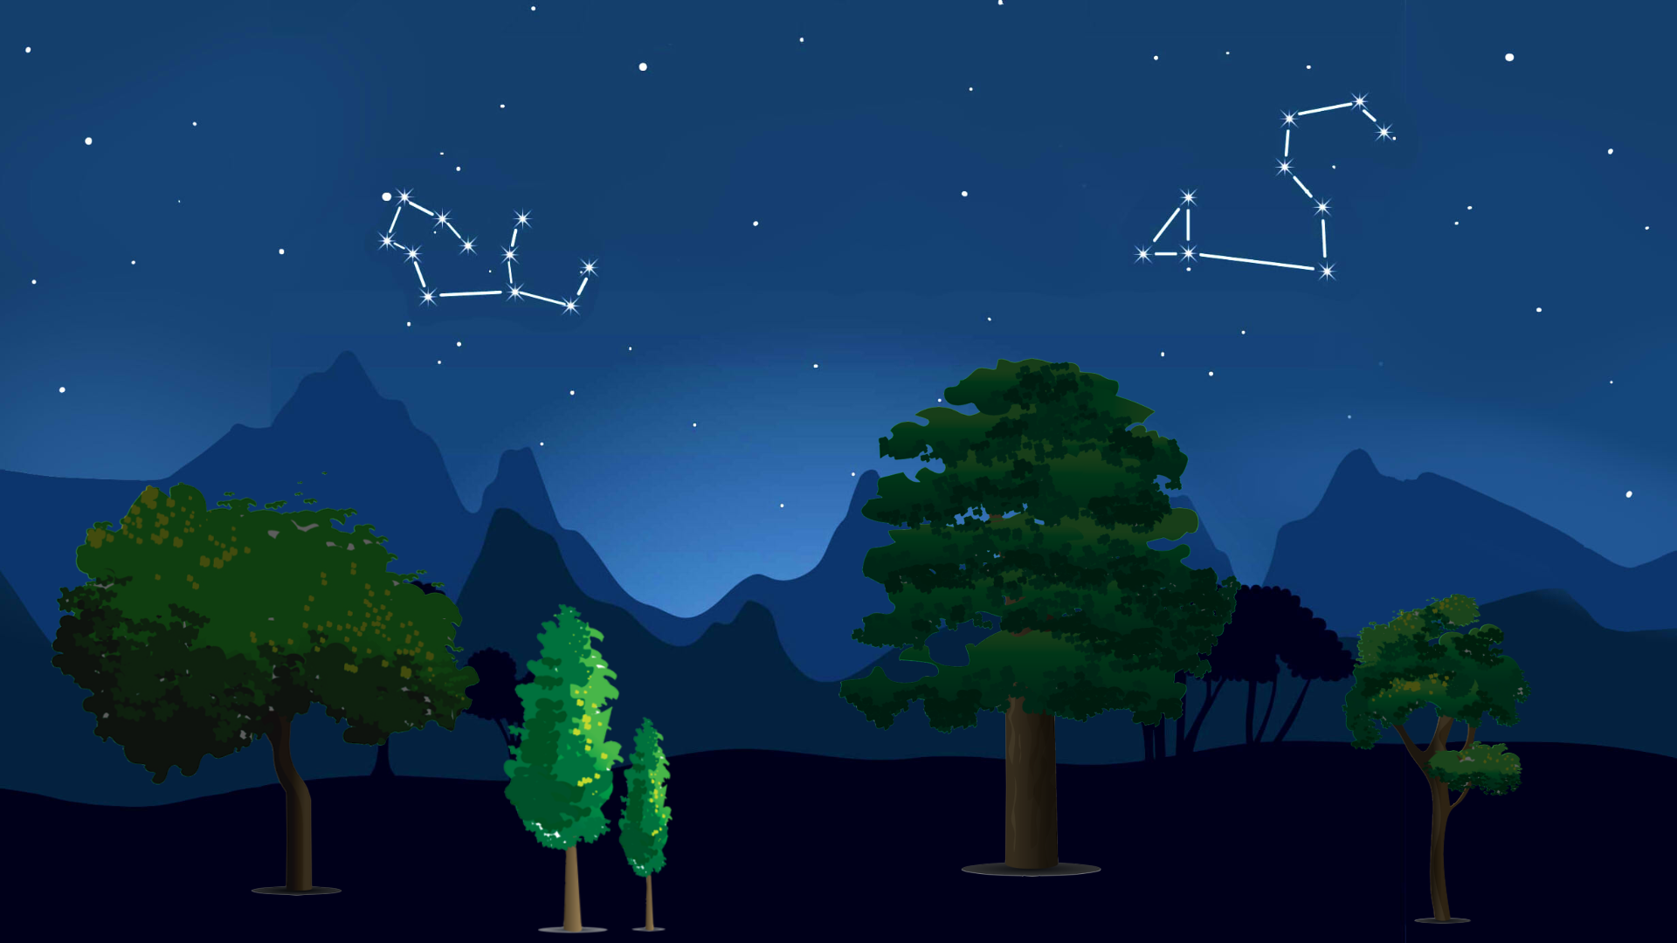
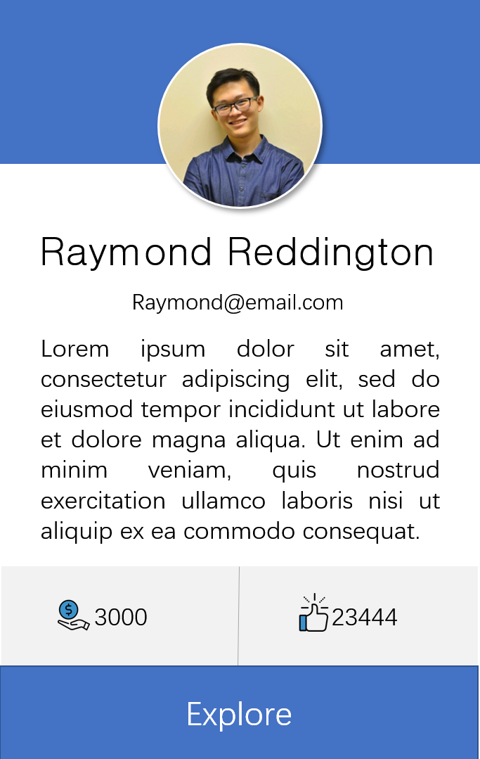
Login

Slide 12
Feature：

Slide 13
Further development
Technical improvement: incorporate machine learning to do recommendation and filtering algorithm
Media and trend leading, socializing factor

Slide 14
Further Improvement
Students who need urgent money esp those with project ideas
Investors willing to help fund projects and locate talents

